Slide 1
Parkinson's Disease Prediction by analyzing Micrographia

Slide 2
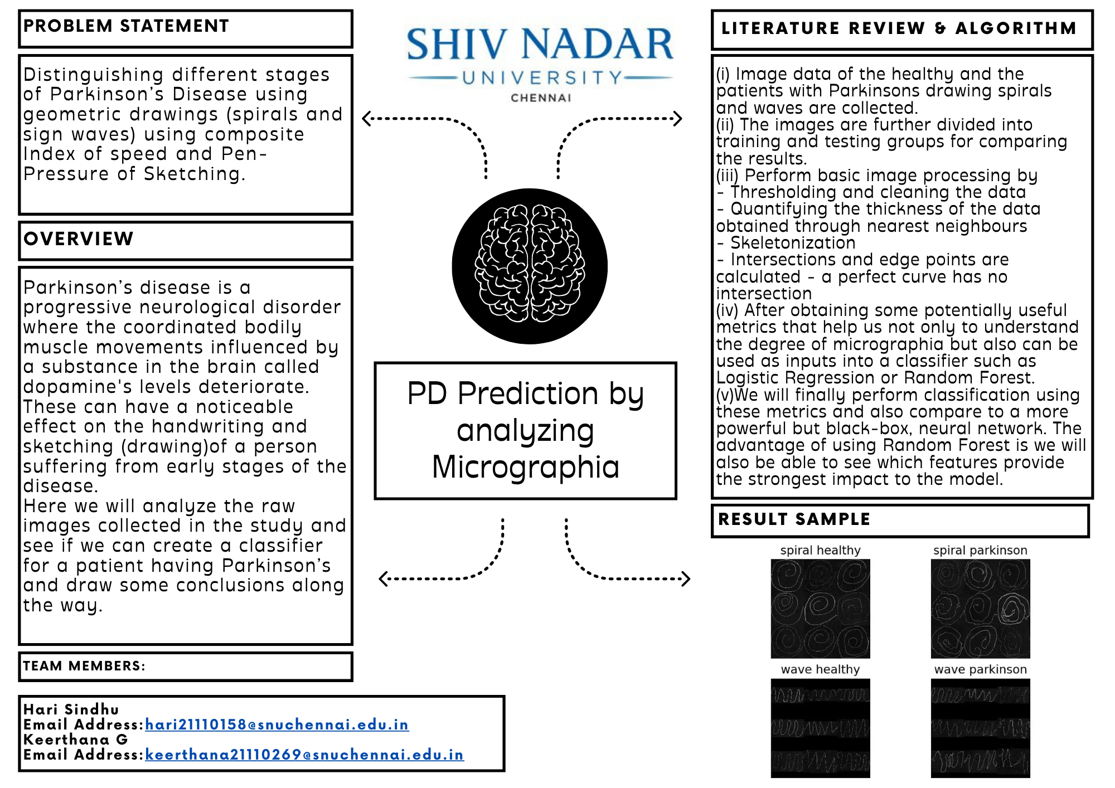

Slide 3
What is Parkinson’s Disease???
Parkinson's disease is a long-term degenerative idiopathic, progressive disorder that affects the nervous system and the parts of the body controlled by the nerves.
This is marked by tremors, muscular rigidity and slow imprecise movements.
It causes slow motor movements, depression, anxiety, sleep and sensory system disorders and other behavioral changes.
Researches show that the drawing speed was slower and the pen pressure lower among Parkinson’s patients — this was especially pronounced for patients with a more acute/advanced forms of the disease.
Spiral drawing is a skilled and complex coordinated motor activity. Therefore, it is treated as a sensitive motor assessment and a preliminary test for early symptoms of Parkinson’s disease.

Slide 4
The main idea behind the implementation is to classify a person as Healthy or having Parkinson’s disease by looking at the Spiral Drawing made by the person. The Spiral Drawing created by a healthy person will look almost similar to a standard spiral shape. However, a spiral drawn by a person with Parkinson’s disease will highly deviate from a perfect spiral shape and look distorted due to slow motor movements and decreased coordination between hand and brain.

Slide 5
The five stages of Parkinson
Stage 1
Stage 5
Stage 3
Mild symptoms that do not typically interfere with daily life, including tremors and movement issues on only one side of the body.
Loss of balance and movements with falls becoming frequent and common. The patient is still capable of (typically) living independently.
Likely impossible to walk or stand. The patient is most likely wheelchair bound and may even experience hallucinations.
Stage 2
Stage 4
Symptoms continue to become worse with both tremors and rigidity now affecting both sides of the body. Daily tasks become challenging.
Symptoms become severe and constraining. The patient is unable to live alone and requires help to perform daily activities.

Slide 6
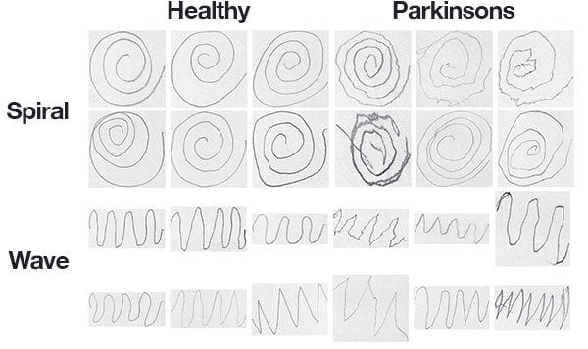
About the data
The dataset consists of 204 images and is pre-split into a training set and a testing set, consisting of:
SPIRAL: 102 images, 72 training, and 30 testing
WAVE: 102 images, 72 training, and 30 testing

Slide 7
Implementation using CNN
To implement the prediction model we throw deep learning and Convolutional Neural Networks (CNNs) at the problem
So why ConvNet over other classification algorithms?
A Convolutional Neural Network (ConvNet/CNN) is a Deep Learning algorithm that can take in an input image, assign importance (learnable weights and biases) to various aspects/objects in the image, and be able to differentiate one from the other.
The pre-processing required in a ConvNet is much lower as compared to other classification algorithms.
Convolutional Neural Networks (ConvNets or CNNs) are a category of Neural Networks that have proven very effective in areas such as image recognition and classification.
Its built-in convolutional layer reduces the high dimensionality of images without losing its information
To start, we don’t have much training data, only 72 images for training. When confronted with a lack of tracking data we typically apply data augmentation — but data augmentation in this context is also problematic.

Slide 8
Why Data Augmentation?
The dataset contains significantly fewer images per category in both train and test sets. Augmentation of the dataset artificially creates images for training and testing.
ImageDataGenerator is used to produce new images. The rotation range is set to 360 as the images are spiral and can be rotated any number of degrees without changing the image’s meaning(horizontal flip & vertical flip).
While applying augmentation on certain transformations it significantly lowered the CNN model’s lower accuracy.
This is evidently seen while augmenting the wave data.
Now the training data’s sample size has increased from 72 to 5112 images and hence ready to be trained.

Slide 9
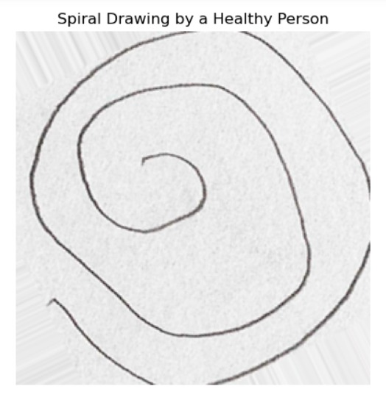
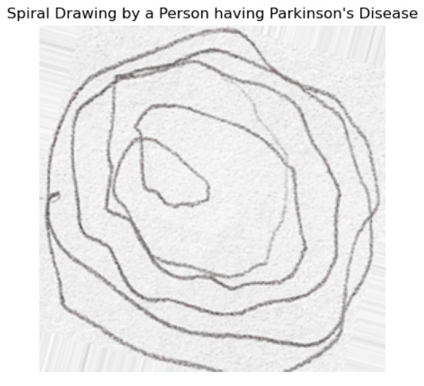
Augmented data – Spiral drawing

Slide 10
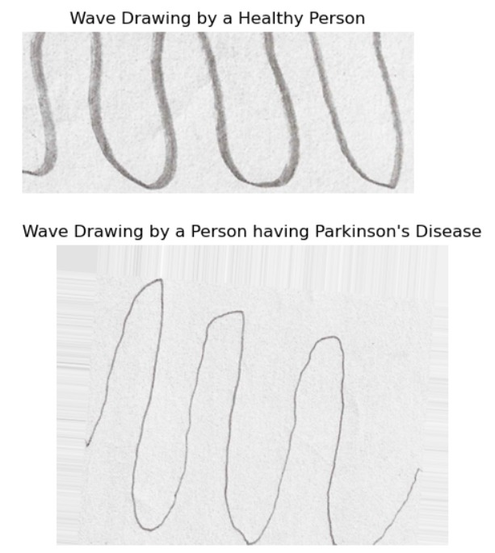
Augmented data – Wave drawing

Slide 11
Training & Model fitting
The implementation uses a CNN model architecture with the following characteristics —
The Input layer in CNN contains image data. Image data is represented by three dimensional matrix.
You need to reshape it into a single column.
The model contains four Convolutional Layers with 128, 64, 32, and 32 filters, respectively.
The convolutional layers contain filters with varying filter sizes.
Also called feature extractor layer because features of the image are get extracted within this layer.
Then we slide the filter over the next receptive field of the same input image by a Stride and do the same operation again. We will repeat the same process again and again until we go through the whole image. The output will be the input for the next layer.
A MaxPool2D layer follows each convolutional layer.
Max pooling is only way to reduce the spatial volume of input image.
Two Fully Connected layers follow the convolutional block. Fully connected layer involves weights, biases, and neurons. It connects neurons in one layer to neurons in another layer. It is used to classify images between different category by training.
ReLU activation is used to make all negative value to zero. Softmax is for multi-classification.(multi class classification)
Output layer contains the label which is in the form of one-hot encoded.

Slide 12
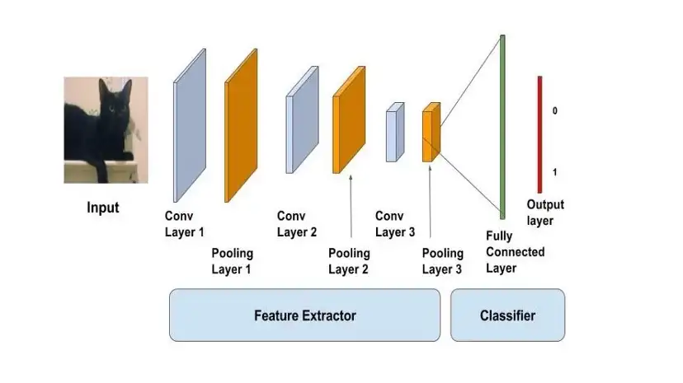

Slide 13
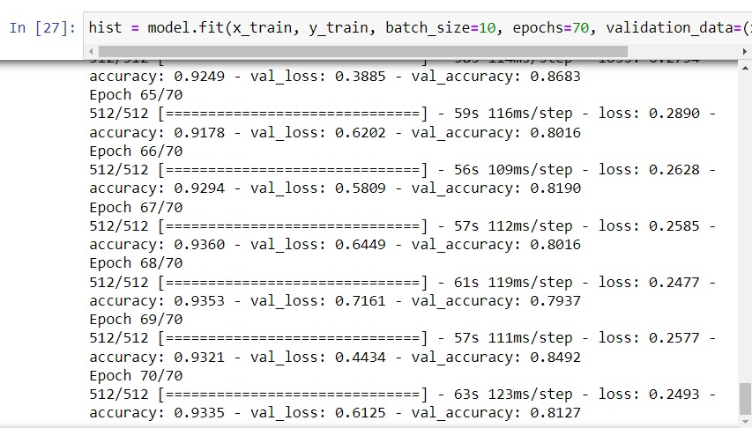
Accuracy of Wave Model

Slide 14
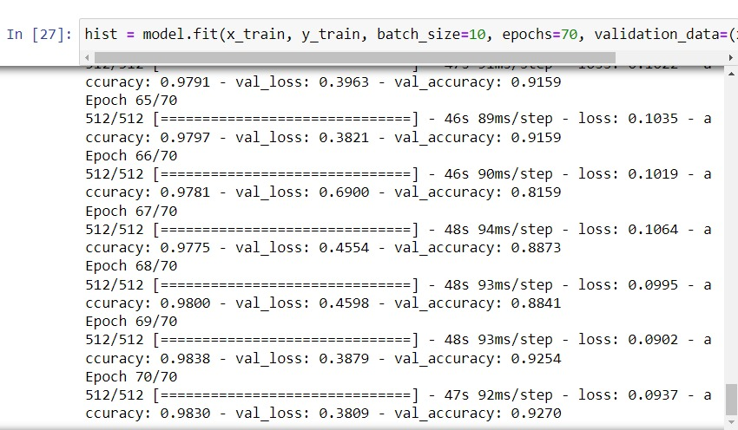
Accuracy of Spiral Model

Slide 15
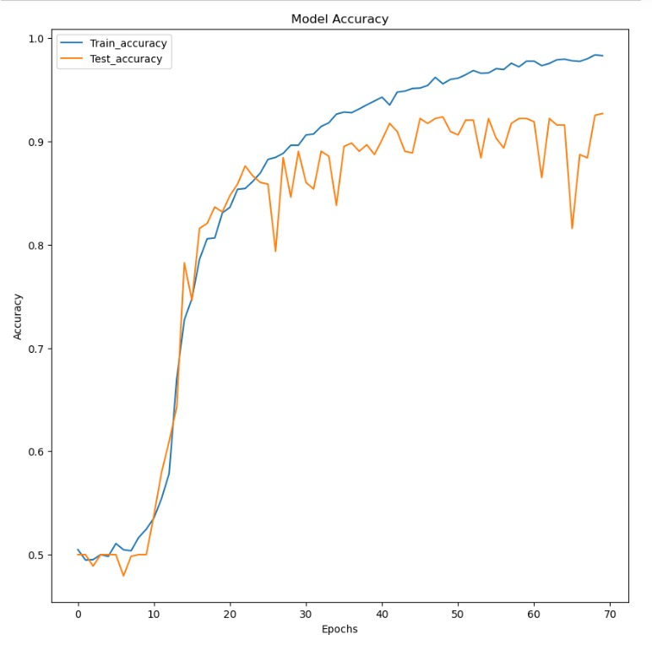
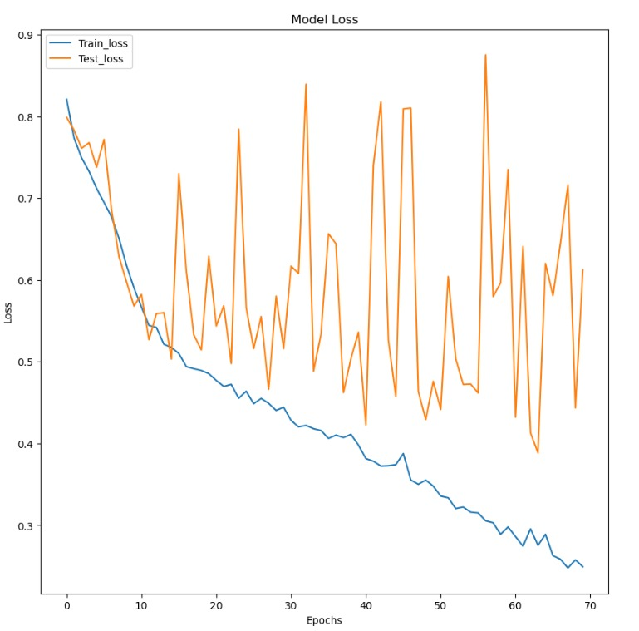

Slide 16
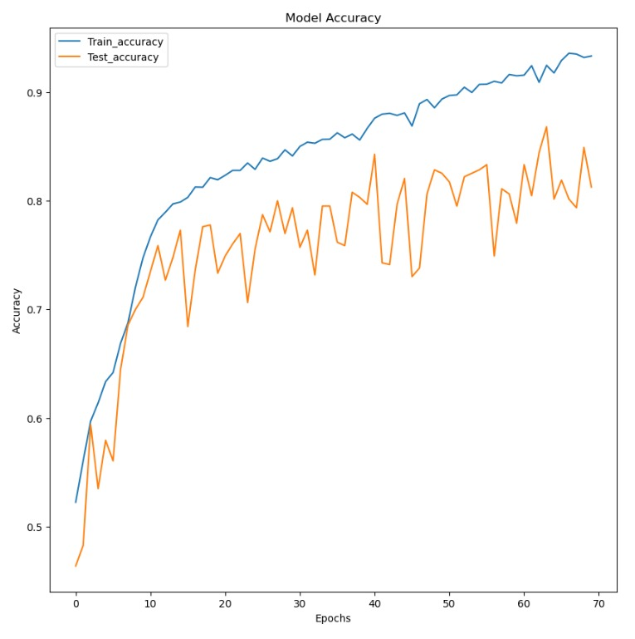
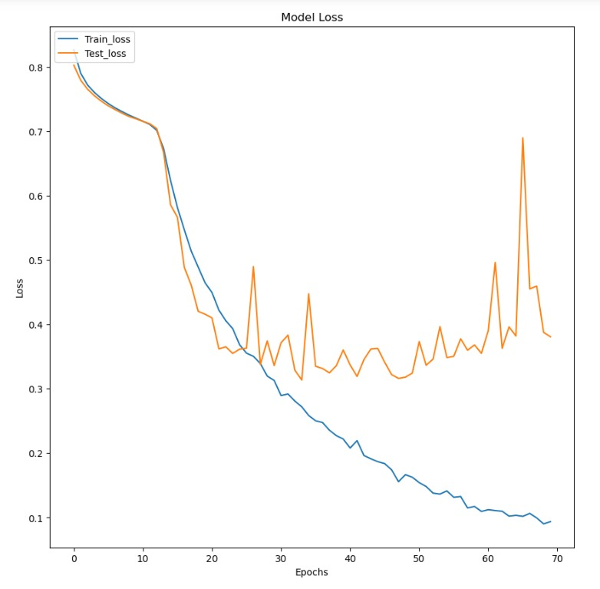

Slide 17
Resources
https://www.kaggle.com/code/brsdincer/parkinson-prediction-by-hand-drawing-dl-ml-process
https://www.kaggle.com/code/stpeteishii/parkinson-s-drawings-densenet201
https://medium.com/ai-techsystems/parkinsons-disease-detection-using-spiral-drawings-and-cnn-b82de9f3ed73
https://pyimagesearch.com/2019/04/29/detecting-parkinsons-disease-with-opencv-computer-vision-and-the-spiral-wave-test/
https://arxiv.org/ftp/arxiv/papers/2101/2101.05631.pdf
https://www.youtube.com/watch?v=eKy3KgRgDkQ
https://aircconline.com/csit/papers/vol12/csit121523.pdf
https://www.youtube.com/watch?v=eKy3KgRgDkQ
https://laptrinhx.com/detecting-parkinson-s-with-opencv-computer-vision-and-the-spiral-wave-test-3813156616/

